Slide 1
MMA 869 Machine Learning & AI Session 4: Enhancing the ML Process
Nasrin Yousefi

Slide 2
Guide to Success
Do feature engineering
Try a few different ML algorithms
Tune the hyperparameters of each algorithm
Use cross validation for accurate estimates
Follow best practices to avoid leakage
Remove bad/useless features via feature selection
Deal with class imbalance

Slide 3
Big Picture
Experiment with FE steps
Find best values with Hyperparameter Tuning
Run CV to estimate F1 Score, Accuracy, etc.
Impute
max_depth=4, …
Scale
Sample
DT
Model
Select
raw
…
transformed
Experiment with a few different algorithms

Slide 4
Feature Engineering

Slide 5
Motivation
Why is Bob sad?
Date | Sad?
"2019-07-29" | Yes
"2019-08-05" | No
"2019-08-12" | Yes
"2019-07-28" | No
"2019-08-03" | No
"2019-08-10" | No
…
Date | Day of Week | Sad?
"2019-07-29" | Monday | Yes
"2019-08-05" | Wednesday | No
"2019-08-12" | Monday | Yes
"2019-07-28" | Sunday | No
"2019-08-03" | Saturday | No
"2019-08-10" | Saturday | No
…
Raw feature
Engineered feature

Slide 6
Feature Engineering is a Big Deal
Feature engineering: creating new features to allow machine learning algorithms to work better
Uses human creativity
"Applied machine learning is basically feature engineering." - Andrew Ng
Notes:
Why?
There is almost never a single model fit or feature set that will immediately solve the problem
The process is more likely to be a campaign of trial and error to achieve the best results
The effect of feature sets can be much larger than the effect of different models
The interplay between models and features is complex and somewhat unpredictable
With the right set of features, is it common that many different types of models can achieve the same level of performance

Slide 7
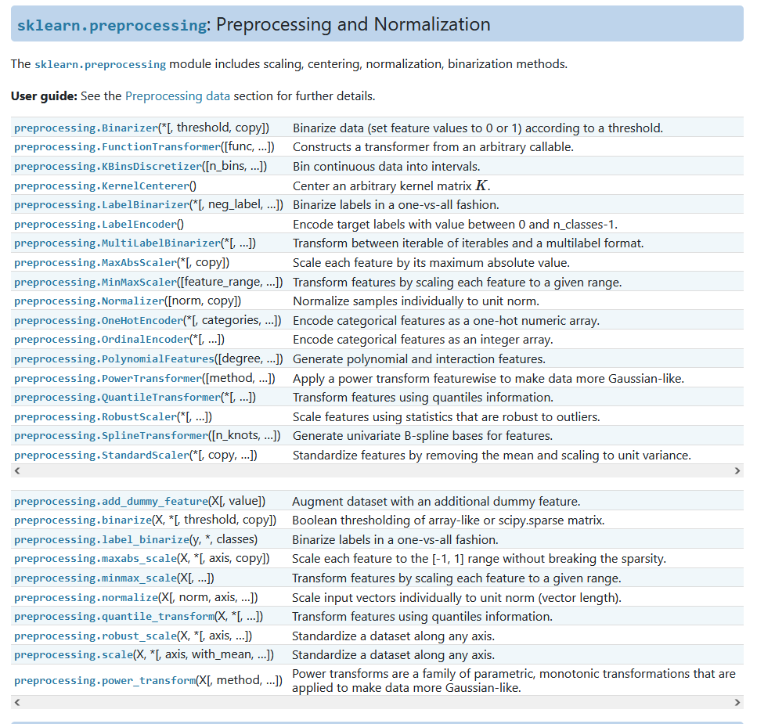
Awesome Tools
Python
sklearn.preprocessing
category_encoders
Featuretools
autofeat
Tsfresh
dirty_cat
Mlxtend

Slide 8
Handling Missing Data
ID | Age | Gender | Income | Status | Children | Job | Buy?
1 |  | A | 150,000 |  | 1 | Engineer | No
2 | 27 | B | 50,000 |  |  | Teacher | No
3 |  | A | 100,000 | Married | 2 |  | Yes
4 | 25 | B |  |  | 2 | Engineer | Yes
5 | 35 | B |  | Single | 0 | Doctor | Yes
6 |  | A | 50,000 |  | 0 | Teacher | No
7 | 33 | B | 60,000 | Single |  | Teacher | No
8 | 20 | B | 10,000 |  |  | Student | No
Solutions:
Manually fix missing values
Use algorithms that are robust to missing data
Delete features and/or instances with missing values
Imputation (Simple or Multiple)
Table from Table 5.2 of Designing Machine Learning Systems, Chip Huyen

Slide 9
Solution: Manually Fix
Sometimes, missing values have a "meaning"
Replace NaNs with meaningful value
Ideal situation: easiest fix
Replace NaNs with "No Alley"
ID | Address | HouseType | Bedrooms | Alley | Price
1 | 3638 Robson St | Apartment | 3 | NaN | 649155
2 | 2301 Pine Street | Duplex | 4 | Gravel | 723127
3 | 1682 Bayfield St | Detached | 2 | NaN | 751975
4 | 1674 Bayfield St | Single | 2 | NaN | 816670
5 | 2633 Pape Ave | Single | 3 | Paved | 321588
6 | 503 Queens Bay | Apartment | 3 | Paved | 922380
House Price Data

Slide 10
Solution: Use Robust Algorithms
Some algorithms can handle missing data internally
XGBoost
LGBM
CatBoost
You don't have to do anything
Alley?
Gravel
NaN
Paved
ID | Address | HouseType | Bedrooms | Alley | Price
1 | 3638 Robson St | Apartment | 3 | NaN | 649155
2 | 2301 Pine Street | Duplex | 4 | Gravel | 723127
3 | 1682 Bayfield St | Detached | 2 | NaN | 751975
4 | 1674 Bayfield St | Single | 2 | NaN | 816670
5 | 2633 Pape Ave | Single | 3 | Paved | 321588
6 | 503 Queens Bay | Apartment | 3 | Paved | 922380
House Price Data

Slide 11
Solution: Delete Features and/or Instances
Sometimes simplest to delete features and/or instances with missing data
If a feature is mostly NaN
If only a few instances with NaN
Feature mostly NaN
ID | Salary | Age | City | Job Title
1 | 56214 | 56 | Toronto | NaN
2 | 157784 | 42 | Kingston | NaN
3 | 49554 | 29 | Toronto | NaN
4 | 36548 | 22 | Ottawa | NaN
5 | 84577 | 54 | Kingston | Sr. Analyst II
6 | Nan | 87 | NaN | NaN
Instance with NaN

Slide 12
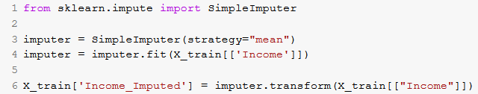
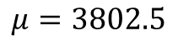
Solution: Simple Imputation
Calculate mean value (on training data)
Replace NaNs (on training and testing) with mean
Notes:
Can also use median
For categorical features: use most frequent value
Can add missing indicator as well
Income
NaN
6836
2319
1236
5003
886
1442
2978
NaN
5400
NaN
2996
3780
4211
8543
Income_Imputed
3802.5
6836
2319
1236
5003
886
1442
2978
3802.5
5400
3802.5
2996
3780
4211
8543
Income_Missing
1
0
0
0
0
0
0
0
1
0
1
0
0
0
0
$$μ=3802.5$$

Slide 13

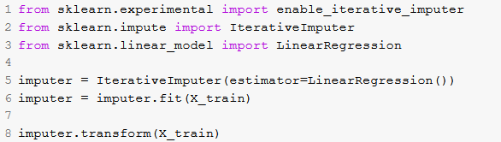
Solution: Multiple Imputation
Model trained on training data to predict missing values using other features
Linear Regression, KNN, Decision Tree
Use model to replace NaNs (on training and testing)
Notes:
No packages in Python support multiple imputation for categorical
MICE package in R does support numeric and categorical
Not recommended: A lot of trouble for little (or no) gain
Age | Income
34 | NaN
54 | 6836
29 | 2319
28 | 1236
53 | 5003
25 | 886
32 | 2442
68 | 2978
30 | NaN
23 | 5400
51 | NaN
47 | 5996
76 | 5780
45 | 4211
30 | 3543
Age | Income_Imputed
34 | 3388.3
54 | 6836
29 | 2319
28 | 1236
53 | 5003
25 | 886
32 | 2442
68 | 2978
30 | 3154.13
23 | 5400
51 | 4383.4
47 | 5996
76 | 5780
45 | 4211
30 | 3543
Linear Regression Model

Slide 14

Missing Data: More Info
Free online text if interested to learn more!
https://stefvanbuuren.name/fimd

Slide 15
Transformations
Transformations take one or more features and create one or more new features.
Today:
Scaling
Discretization
Encoding

Slide 16
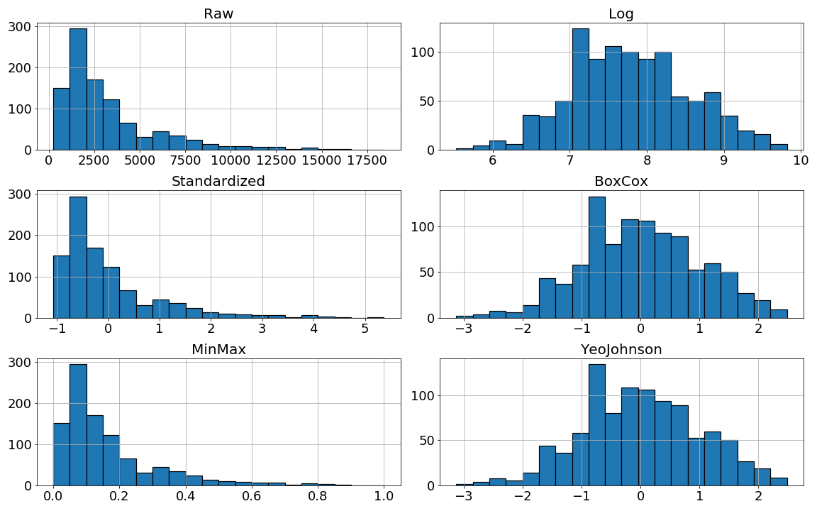
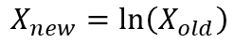
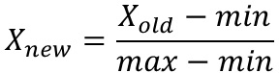
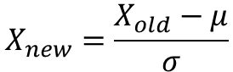
Scaling
Scaling: any transformation that changes the values of a feature to either fall within a different range, or have a new distributional shape, or both.
$$X_{new}=\ln\left(X_{old}\right)$$
$$X_{new}=\frac{X_{old}−μ}{σ}$$
$$X_{new}=\frac{X_{old}−min}{max−min}$$

Slide 17
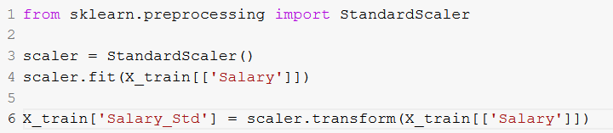
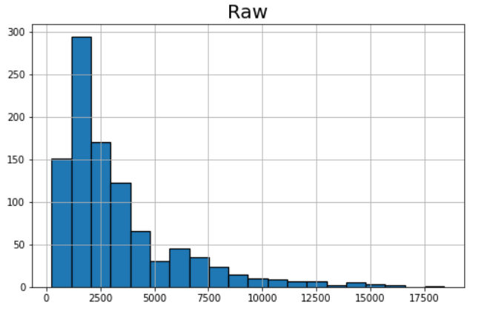
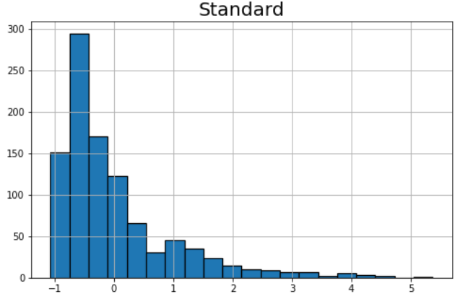
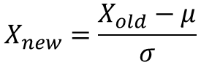
Standardization
PID | Salary
29 | 6836
535 | 2319
695 | 1236
557 | 5003
836 | 886
596 | 1442
165 | 2978
918 | 2359
495 | 2996
824 | 3780
$$X_{new}=\frac{X_{old}−μ}{σ}$$
PID | Salary_Std
29 | 1.199912
535 | -0.359630
695 | -0.733547
557 | 0.567050
836 | -0.854388
596 | -0.662423
165 | -0.132103
918 | -0.345819
495 | -0.125888
824 | 0.144796
Centers and scales
Recommended
Good for SVM
Good for NN
Good for l1, l2 regularization,
Good for distance metrics (KNN)
Not needed for tree-based

Slide 18
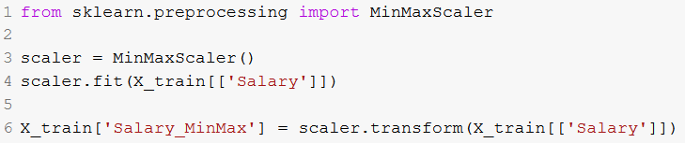
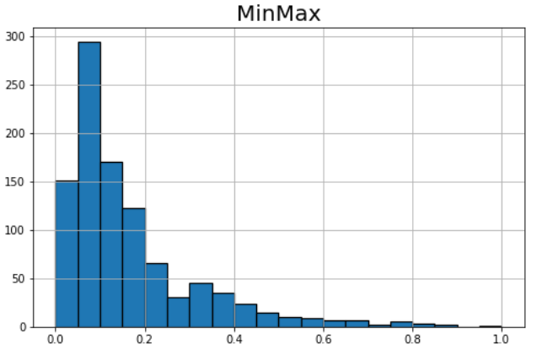
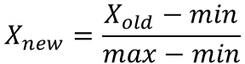
Min-Max Scaling (Normalization)
PID | Salary
29 | 6836
535 | 2319
695 | 1236
557 | 5003
836 | 886
596 | 1442
165 | 2978
918 | 2359
495 | 2996
824 | 3780
Scales
Good for NN
$$X_{new}=\frac{X_{old}−min}{max−min}$$
PID | Salary_MinMax
29 | 0.362386
535 | 0.113844
695 | 0.054253
557 | 0.261527
836 | 0.034995
596 | 0.065588
165 | 0.150105
918 | 0.116045
495 | 0.151095
824 | 0.194234

Slide 19
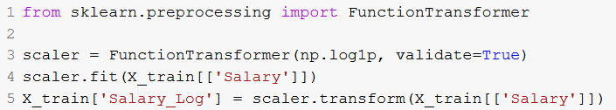
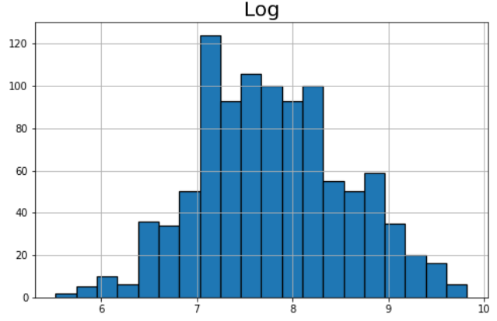
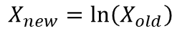
Log
PID | Salary
29 | 6836
535 | 2319
695 | 1236
557 | 5003
836 | 886
596 | 1442
165 | 2978
918 | 2359
495 | 2996
824 | 3780
De-skews
Removes effect of outliers
Good? Try to see
$$X_{new}=\ln\left(X_{old}\right)$$
PID | Salary_Log
29 | 8.830104
535 | 7.749322
695 | 7.120444
557 | 8.517993
836 | 6.787845
596 | 7.274480
165 | 7.999343
918 | 7.766417
495 | 8.005367
824 | 8.237744

Slide 20
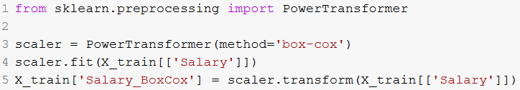
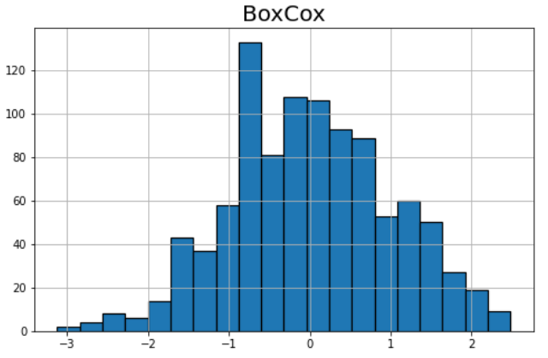
Box-Cox
PID | Salary
29 | 6836
535 | 2319
695 | 1236
557 | 5003
836 | 886
596 | 1442
165 | 2978
918 | 2359
495 | 2996
824 | 3780
De-skews
Removes effect of outliers
Makes more normal/Gaussian
Good? Try to see
PID | Salary_BoxCox
29 | 1.291730
535 | -0.054503
695 | -0.893962
557 | 0.914991
836 | -1.355653
596 | -0.684355
165 | 0.267494
918 | -0.032279
495 | 0.275172
824 | 0.568502

Slide 21
Exercise
Create standardization and min-max scalings of the Age feature:
PID | Age | …
1 | 23
2 | 21
3 | 45
4 | 34
5 | 23
6 | 34
7 | 30
8 | 31
Age_Standard
Age_MinMax
Hint:
Mean = 30.1
Stdev = 7.9

Slide 22
Discretization (Binning)
Discretization: transforming numbers into two or more buckets
CID | Grade | …
1 | 92
2 | 86
3 | 89
4 | 71
5 | 80
6 | 62
CID | Letter | …
1 | A+
2 | A
3 | A
4 | B-
5 | A-
6 | C-
CID | Age | …
1 | 20
2 | 51
3 | 84
4 | 9
5 | 36
6 | 37
CID | Life | …
1 | Young
2 | Old
3 | Old
4 | Young
5 | Middle
6 | Middle

Slide 23
Discretization: Probably Not Good
Kuhn et al. strongly recommends against discretization
Nuance is removed → Harder for model to find pattern
Might make model find trend that is not there
Hard to find cut-off points between buckets

Slide 24
Encoding
Encoding: turning categorical features into numeric features
One hot encoding/Dummy Coding
Ordinal encoding
Target encoding
…
Note: Boosting algorithms (LGBM, CatBoost) do their own encoding

Slide 25
One Hot Encoding
OHE: creating a new numeric feature for each level of a categorical feature
PID | Province | …
1 | ON
2 | QB
3 | AB
4 | ON
5 | ON
6 | BC
7 | AB
8 | BC
PID | Province_QB | Province_AB | Province_ON | Province_BC | …
1 | 0 | 0 | 1 | 0
2 | 1 | 0 | 0 | 0
3 | 0 | 1 | 0 | 0
4 | 0 | 0 | 1 | 0
5 | 0 | 0 | 1 | 0
6 | 0 | 0 | 0 | 1
7 | 0 | 1 | 0 | 0
8 | 0 | 0 | 0 | 1
If there are K levels, then you need K new features
Best when:
small number of levels
no order between values
Notes:
Note that in regression, you often only create K-1 levels to try to limit collinearity. Other models don't really care.

Slide 26
Exercise
Create a OHE of the School feature for the following table:
PID | Age | School | …
1 | 23 | Queen's
2 | 21 | Western
3 | 45 | Queen's
4 | 34 | Yale
5 | 23 | Queen's
6 | 34 | Western
7 | 30 | Yale
8 | 31 | Western

Slide 27
Ordinal Encoding
Ordinal Encoding: creating arbitrary, repeatable mapping from categorical class to an integer
PID | Temp | …
1 | cold
2 | warm
3 | cold
4 | hot
5 | cold
6 | warm
7 | warm
8 | warm
PID | Temp | …
1 | 0
2 | 1
3 | 0
4 | 2
5 | 0
6 | 1
7 | 1
8 | 1
PID | Province | …
1 | ON
2 | QB
3 | AB
4 | ON
5 | ON
6 | BC
7 | AB
8 | BC
PID | Province | …
1 | 3
2 | 1
3 | 2
4 | 3
5 | 3
6 | 4
7 | 2
8 | 4
Levels given by human expert
Possible, but does it make sense?

Slide 28
Target Encoding
Target encoding takes into account the target
E.g., compute mean target value for each level, then replace the categorical value with this mean
PID | Income | Default
1 | Low | 0
2 | Low | 1
3 | Low | 1
4 | Low | 1
5 | Medium | 0
6 | Medium | 0
7 | Medium | 0
8 | Medium | 1
9 | Medium | 1
10 | Medium | 1
11 | High | 0
12 | High | 0
13 | High | 0
14 | High | 0
15 | High | 1
PID | Income_TE | Default
1 | 0.75 | 0
2 | 0.75 | 1
3 | 0.75 | 1
4 | 0.75 | 1
5 | 0.50 | 0
6 | 0.50 | 0
7 | 0.50 | 0
8 | 0.50 | 1
9 | 0.50 | 1
10 | 0.50 | 1
11 | 0.20 | 0
12 | 0.20 | 0
13 | 0.20 | 0
14 | 0.20 | 0
15 | 0.20 | 1
Level | Target Mean
Low | 3/4 = 0.75
Medium | 3/6 = 0.50
High | 1/5 = 0.20

Slide 29
Exercise
Create a target encoding of the School feature for the following table:
PID | Age | School | Default
1 | 23 | Queen's | 1
2 | 21 | Western | 1
3 | 45 | Queen's | 0
4 | 34 | Yale | 1
5 | 23 | Queen's | 0
6 | 34 | Western | 1
7 | 30 | Yale | 0
8 | 31 | Western | 1

Slide 30
Target Encoding: Overfitting
Since Target Encoding uses target, overfitting is a concern
Techniques to help avoid:
Smoothing: add a bit of random noise
Weighted average with global mean
PID | Income | Default
1 | Low | 0
2 | Low | 1
3 | Low | 1
4 | Low | 1
5 | Medium | 0
6 | Medium | 0
7 | Medium | 0
8 | Medium | 1
9 | Medium | 1
10 | Medium | 1
11 | High | 0
12 | High | 0
13 | High | 0
14 | High | 0
15 | High | 1
PID | Income_TE | Default
1 | 0.526 | 0
2 | 0.526 | 1
3 | 0.526 | 1
4 | 0.526 | 1
5 | 0.476 | 0
6 | 0.476 | 0
7 | 0.476 | 0
8 | 0.476 | 1
9 | 0.476 | 1
10 | 0.476 | 1
11 | 0.400 | 0
12 | 0.400 | 0
13 | 0.400 | 0
14 | 0.400 | 0
15 | 0.400 | 1
Level | Target Mean
Low | 3/4 = 0.75
Medium | 3/6 = 0.50
High | 1/5 = 0.20
Global Mean = 0.46

Slide 31
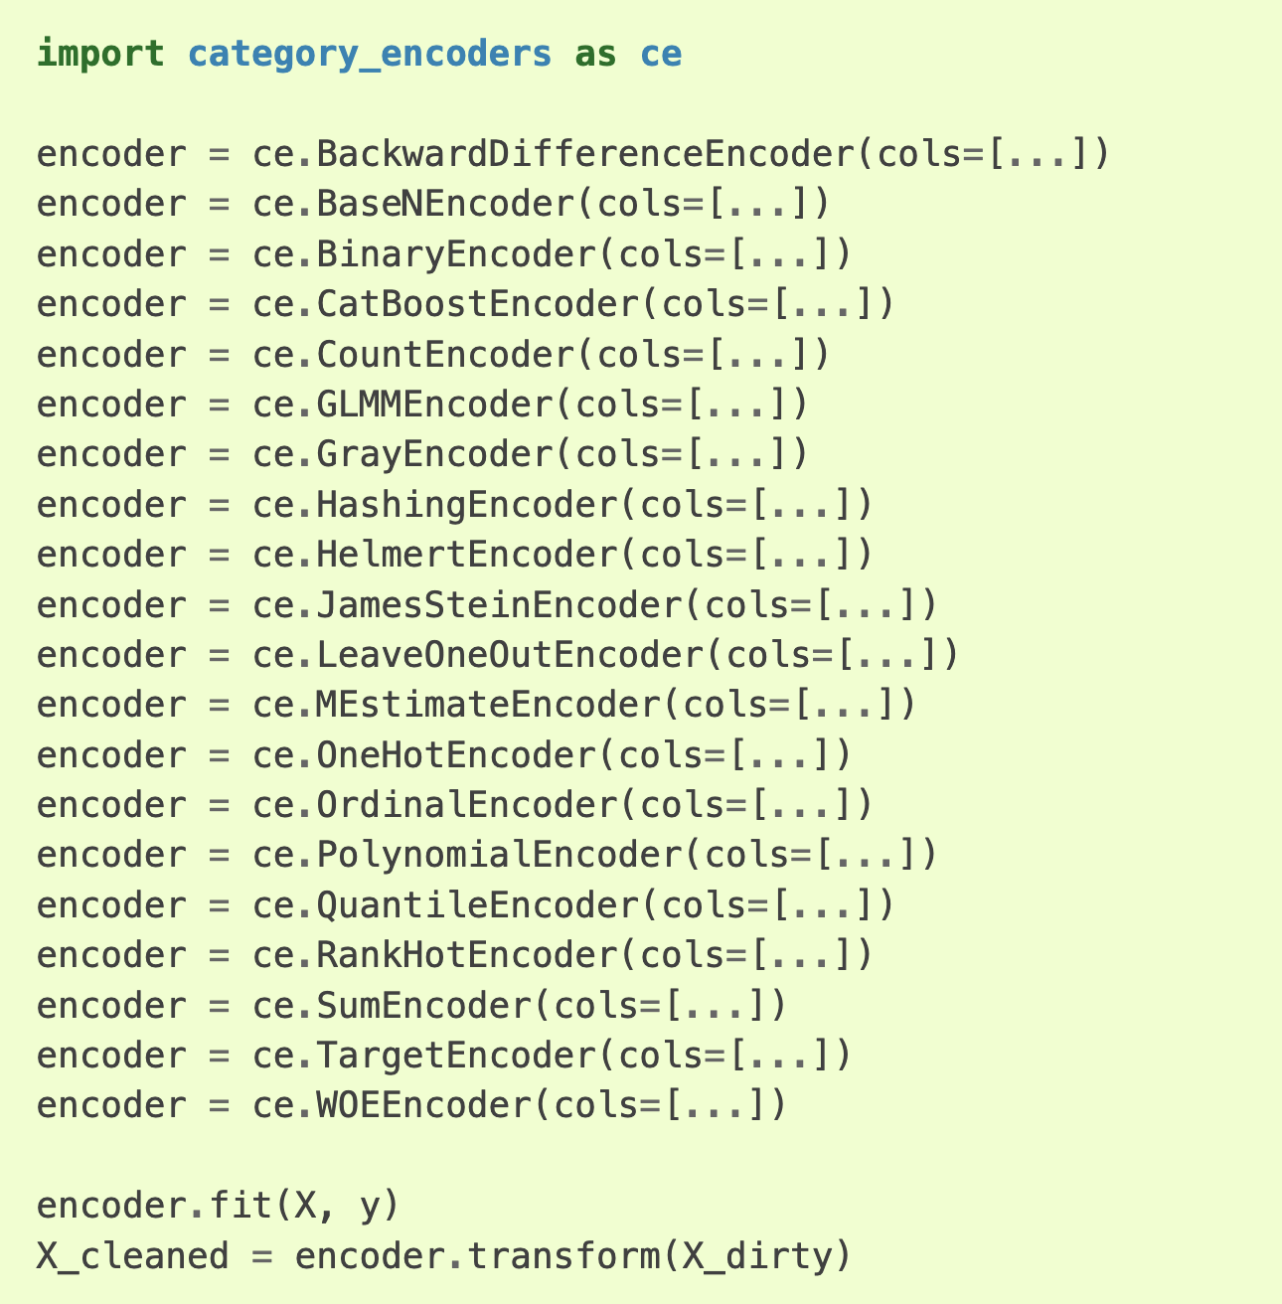
Nice Python Package
Category Encoders package

Slide 32
High-Cardinality Categorical Features
Some categorical features have a lot of unique values
Can replace rare values with "Other"
Value | Count
Steve | 5210
Bob | 3655
Jimmy | 2104
Sue | 563
Meg | 15
Anup | 8
Tom | 3
…
Installer Name
Bob
Steve
Steve
Sue
Tom
Steve
Steve
Bob
Meg
Jimmy
Sue
Steve
Steve
Steve
Anup
….
Installer Name
Bob
Steve
Steve
Sue
Other
Steve
Steve
Bob
Other
Jimmy
Sue
Steve
Steve
Steve
Other
….
Unique values: 500
Unique values: 6

Slide 33
Datetime Features
"2019-08-14 00:30:02:98" = ☹
TID | Date | …
1 | "2019-06-01"
2 | "2019-06-02"
3 | "2019-08-20"
4 | "2019-12-16"
5 | "2020-01-01"
6 | "2019-08-18"
TID | isWeekend? | Day | Month | Year | Decade | Days Since 2018 | …
1 | True | Saturday | June | 2019 | 2010s | 152
2 | True | Sunday | June | 2019 | 2010s | 153
3 | False | Tuesday | August | 2019 | 2010s | 232
4 | False | Monday | December | 2019 | 2010s | 350
5 | False | Wed | January | 2020 | 2020s | 366
6 | True | Sunday | August | 2019 | 2010s | 230
Others?

Slide 34
Non-Linear Mathematical Transformations
Apply mathematical transformation to a feature
sqrt(x)
1/x
x², x³
|x|
2^{x}
sin(x)
log(x)
cos(x)
Age
23
21
45
34
23
34
30
31
1/Age
0.043
0.047
0.022
0.029
0.043
0.029
0.033
0.032
sin(Age)
-0.846
0.837
0.851
0.529
-0.846
0.529
-0.988
-0.404

Slide 35
Feature Combinations/Crossings
Combine pairs of features with mathematics: +, -, ×, ÷
Height | Weight
150 | 58.2
163 | 84.2
170 | 77.0
145 | 68.1
185 | 100.5
Height × Weight
8730.0
13724.6
13090.0
9874.5
18592.5
Height ÷ Weight
2.58
1.94
2.21
2.13
1.84

Slide 36
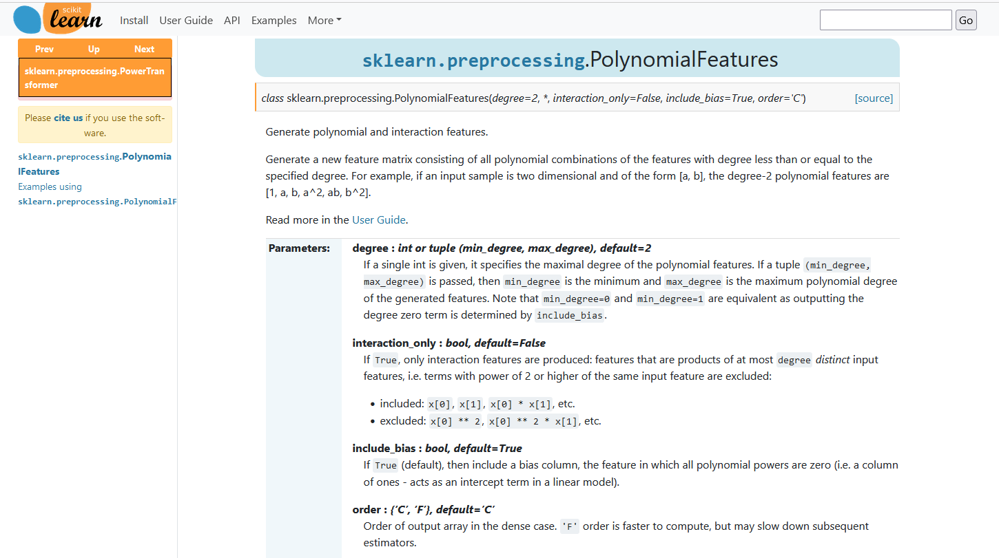
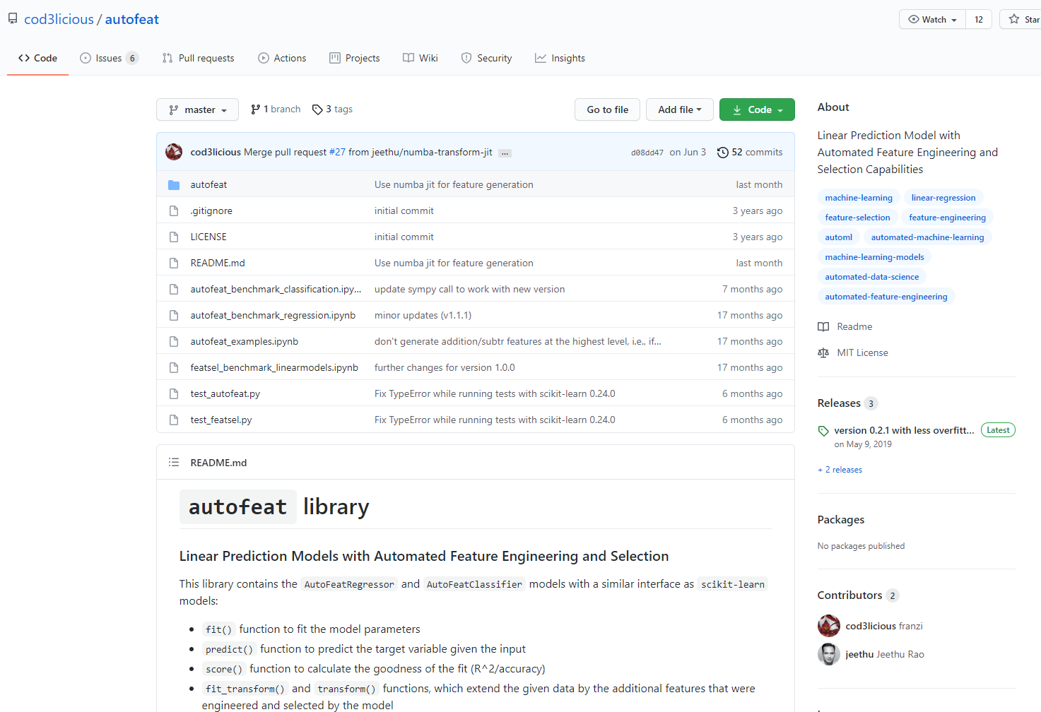
Packages

Slide 37
Aggregations
Aggregations take one or more (related) instances and create one new instance.
Useful when you have several transactions per client, but want to build a model at the client level
Transactions
Aggregated by Client
TID | CID | Date | Spend
1 | 498 | 2019-06-01 | $10.58
2 | 658 | 2019-06-01 | $63.54
3 | 498 | 2019-06-02 | $87.96
4 | 325 | 2019-06-03 | $56.66
5 | 987 | 2019-06-07 | $25.00
6 | 498 | 2019-06-18 | $63.05
CID | Count | Spend_min | Spend_max | Date_max | …
498 | 10 | $5.21 | $156.32 | 2019-08-01
658 | 43 | $2.32 | $63.54 | 2019-07-25
325 | 1 | $87.99 | $87.99 | 2019-06-03
987 | 19 | $56.33 | $196.65 | 2019-08-07
pandas groupby() makes this easy

Slide 38
Exercise
What aggregated features can you think of?
Transaction ID | Customer ID | Date | Product ID | Spend
1 | 498 | 2019-06-01 | 5 | $10.58
1 | 498 | 2019-06-01 | 2 | $63.54
1 | 498 | 2019-06-01 | 3 | $87.96
2 | 658 | 2019-06-03 | 4 | $56.66
2 | 658 | 2019-06-03 | 7 | $25.00
3 | 498 | 2019-06-18 | 9 | $63.05
3 | 498 | 2019-06-18 | 9 | $144.66
4 | 125 | 2019-06-18 | 5 | $76.56
…
Customer ID | ?? | ?? | ?? | ?? | …
498
658
125
987
…
Notes:
What else?
You can get very creative in what features you engineer for each customer:
Count: The number of transactions
Count_product: the number of unique products purchased
Min: the minimum transaction amount ever
Max: the maximum transaction amount ever
Mean: the mean transaction amount
Sum: The sum of all transaction amounts
Time between: the average time between transactions
Time since last: the time since the last transaction and now
Time since first: The time since the first transaction and now
Percent great than X: the percentage of transaction amounts that are greater than X
Trend: Are transactions going up, down, or staying the same
Most frequent product: which product is most frequently purchased
Most frequent day: on which day do most transactions occur
…

Slide 39
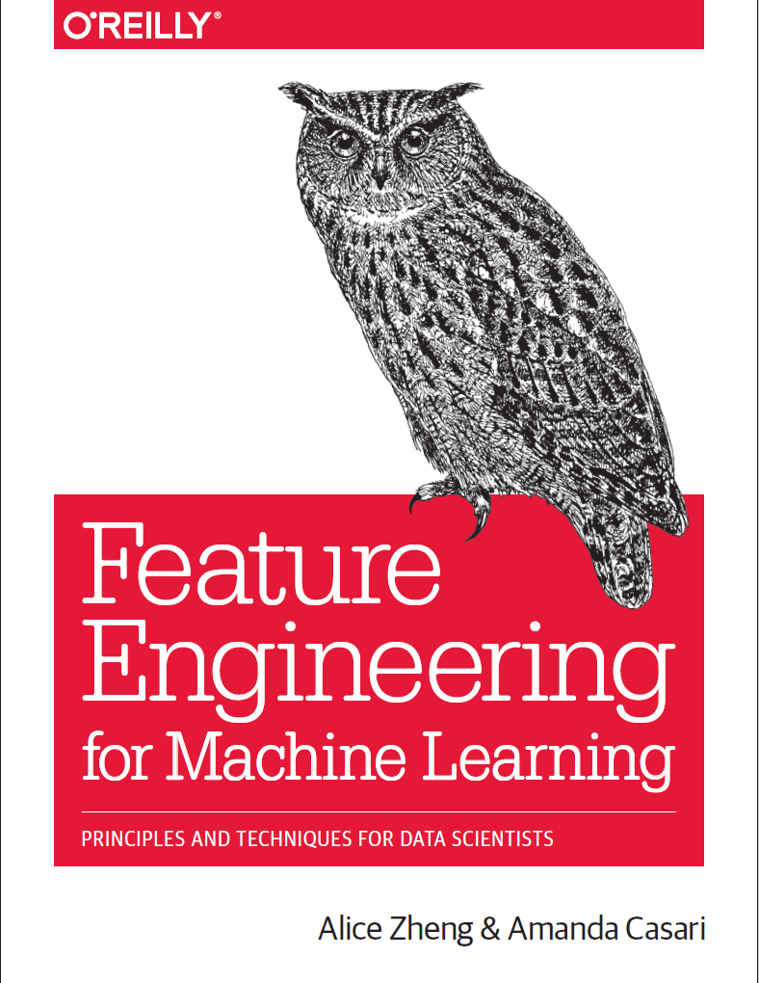
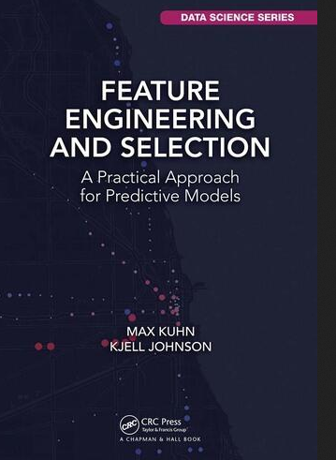
More Information on FE
Free online:
http://www.feat.engineering/index.html

Slide 40
Feature Selection

Slide 41
Feature Selection
Feature selection: process of selecting a subset of features to use in model training
Advantages?
Reduce overfitting
Faster training
Two kinds of techniques
Filter methods
Wrapper methods
Not necessary for tree-based algorithms
Faster
Better
Notes:
Some ML algorithms are sensitive to non-informative features
Reduce size of data → faster running time
If two features are highly correlated, some algorithms will perform badly
Reduce overfitting

Slide 42
Filter Methods
Use stats to remove bad/useless features before model training
Think of it like a data cleaning step
CID | Province | Favorite Color | Height | Shoe Size | Default
1 | ON | Red | 152 | 6.0 | 1
2 | ON | Purple | 185 | 12.0 | 0
3 | ON | Purple | 168 | 10.0 | 0
4 | ON | Blue | 143 | 8.0 | 1
5 | ON | White | 150 | 8.0 | 1
6 | ON | Green | 166 | 8.5 | 0
7 | ON | Green | 167 | 8.0 | 0
8 | ON | Gold | 172 | 11.5 | 1
9 | ON | Yellow | 180 | 12.5 | 0
10 | ON | Red | 177 | 11.0 | 1
Low Variance
Low Correlation with Target
Highly Correlated
Sklearn: VarianceThreshold()
Sklearn: SelectKBest()
Pandas: corr()
Notes:
Inspiration: https://www.analyticsvidhya.com/blog/2016/12/introduction-to-feature-selection-methods-with-an-example-or-how-to-select-the-right-variables/

Slide 43
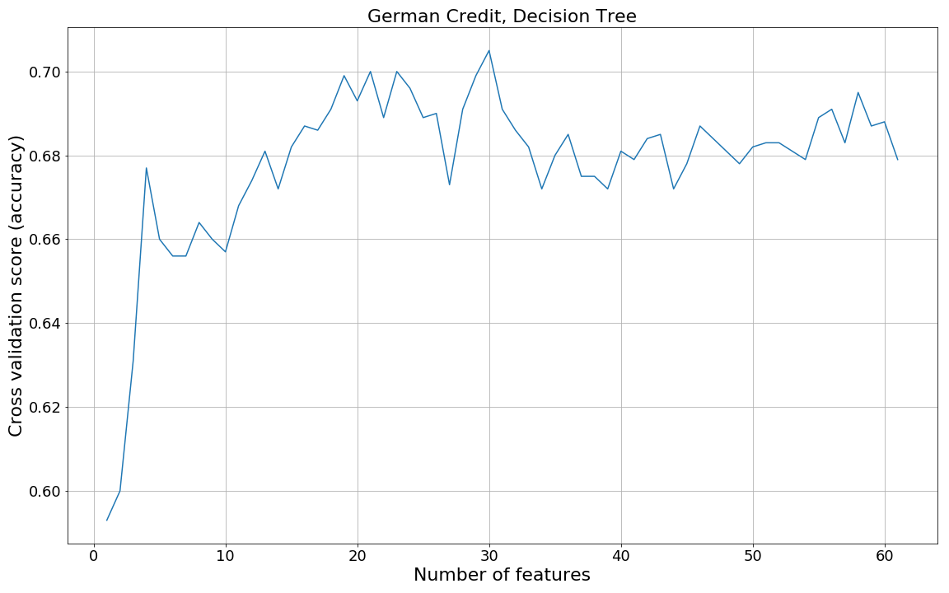
Wrapper Methods
Find the best subset of features by training and evaluating models on many subsets of features
Build model with all features; assess performance
Remove the least-important feature, re-build and re-assess
Repeat
Choose best subset
Sklearn: RFE
Notes:
RFE=Recursive Feature Engineering

Slide 44
Hyperparameter Tuning

Slide 45
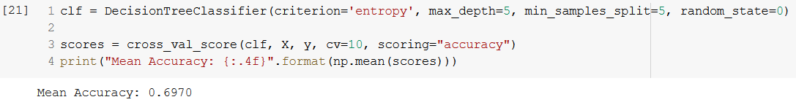
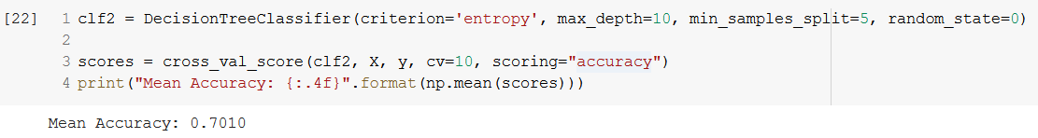
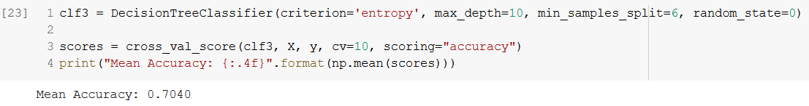
Motivation
Hyperparameters
Good, but can we do better?
Cool! But can we do better?
Nice!
Can keep going forever! Can we automate this?

Slide 46
Hyperparameter Tuning
Hyperparameter tuning: choosing the best values for hyperparameters
Hyperparameters are algorithm's "settings" that are set by the human/data scientist before training begins
Not to be confused with regular parameters that are learned!
Methods:
Grid Search, Random Search, etc.
Algorithm | Hyperparameters | Learned Model Parameters
Decision Tree | criterion, splitter, max_depth, min_samples_split, min_sampels_leaf, min_weight_fraction, max_features, class_weight…
SVM | C, kernel, degree, gamma, coef0, shrinking, tol, class_weight, …
Logistic Regression | C, penalty, tol, fit_intercept, class_weight, …
Neural Network | hidden_layer_sizes, activation_function, alpha, batch_size, learning_rate, max_iter, tol, …
….
Notes:
Gradient search isn't usually a good idea: the functions are not smooth and not convex.

Slide 47
Grid Search
Data scientist defines sets of values for each hyperparameter
Criterion: gini, entropy
Max_depth: 5, 10, 15, 20, 25, 30, 35
Min_samples_leaf: 1, 10, 25, 50, 100
Grid Search builds model for every combo of hyperparameter values
How many total combos above?
Chooses the combination that has best performance metric

Slide 48
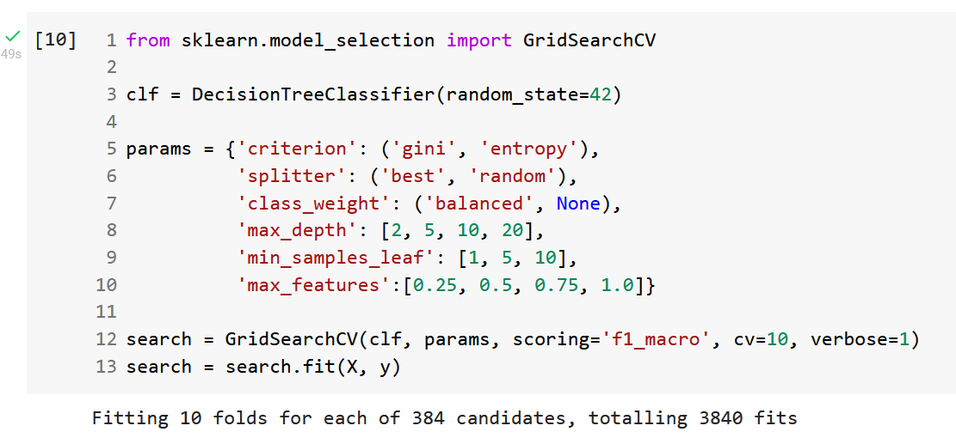
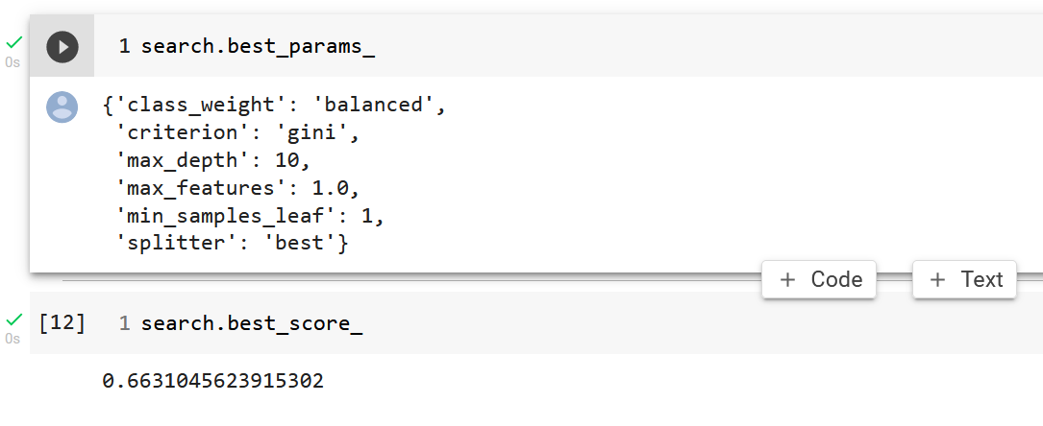
Example

Slide 49
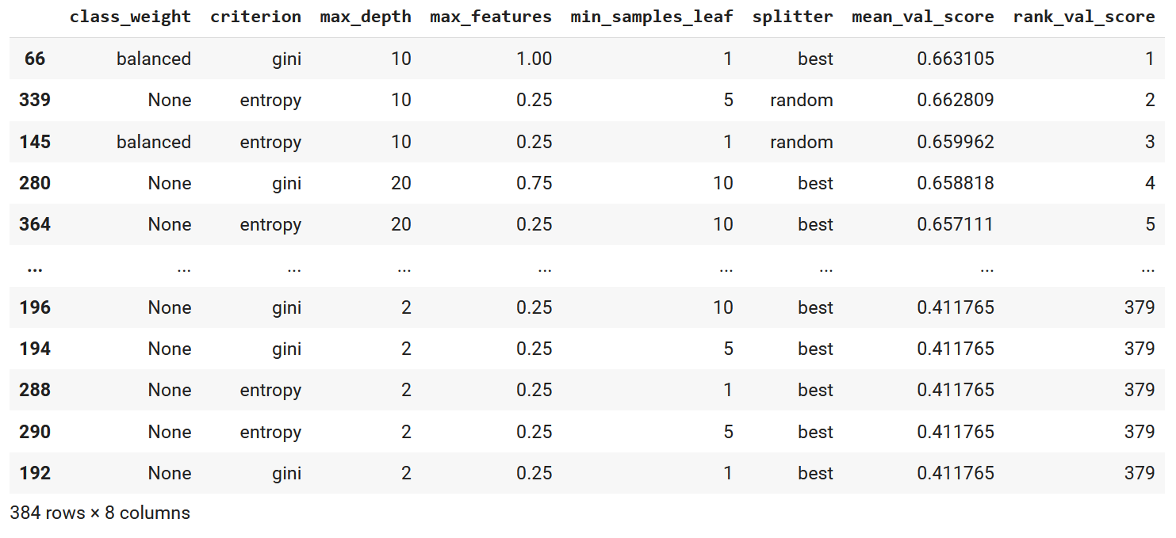
Table

Slide 50
Random Search
Data scientist defines ranges of values for each hyperparameter
Criterion: [gini, entropy]
Max_depth: [5 – 35]
Min_samples_leaf: [1 – 100]
Random Search randomly chooses value in the defined range for each hyperparameter
Does this n (number of iterations) times
Chooses combination that has best performance metric

Slide 51
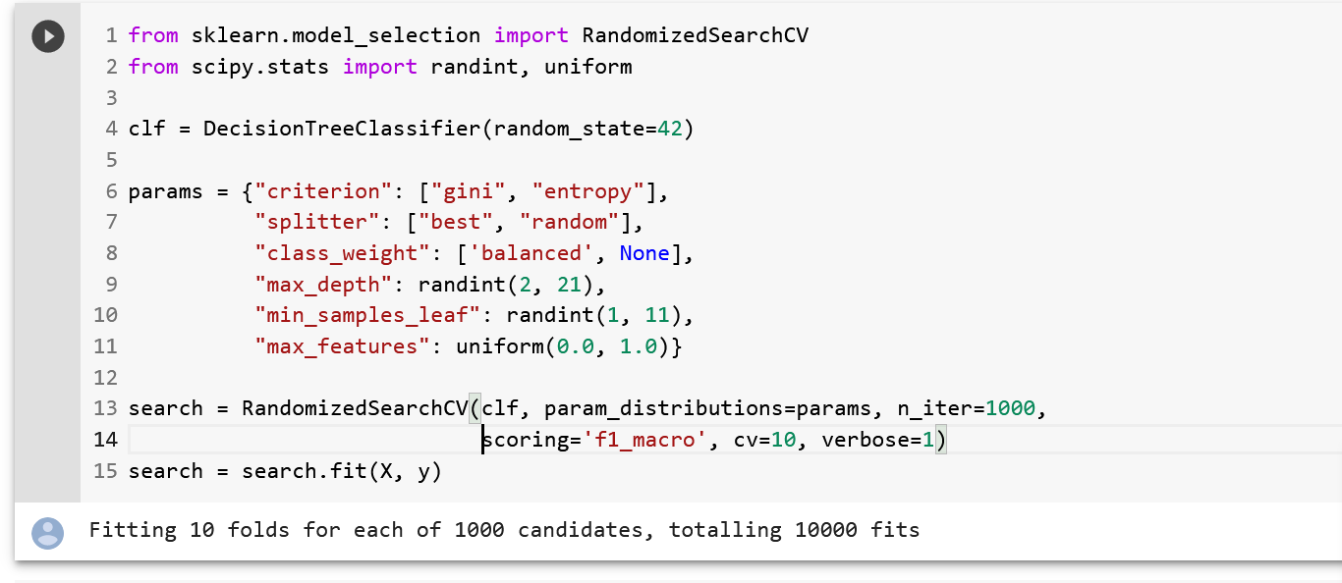
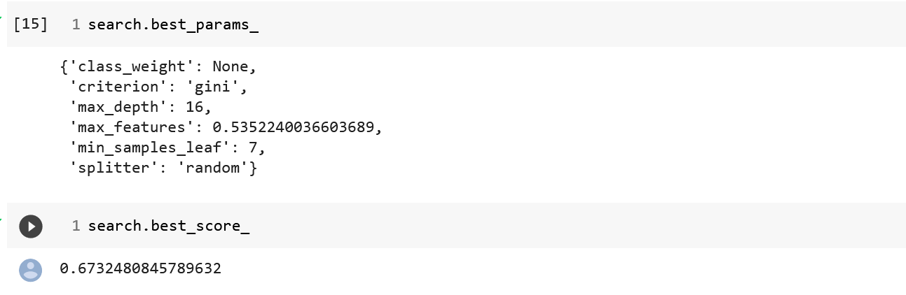
Example

Slide 52
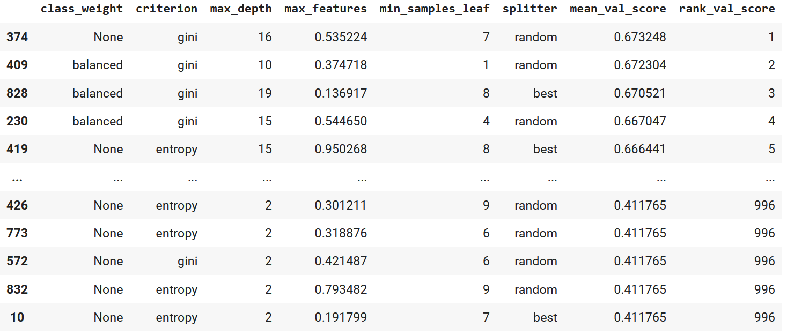
Table

Slide 53




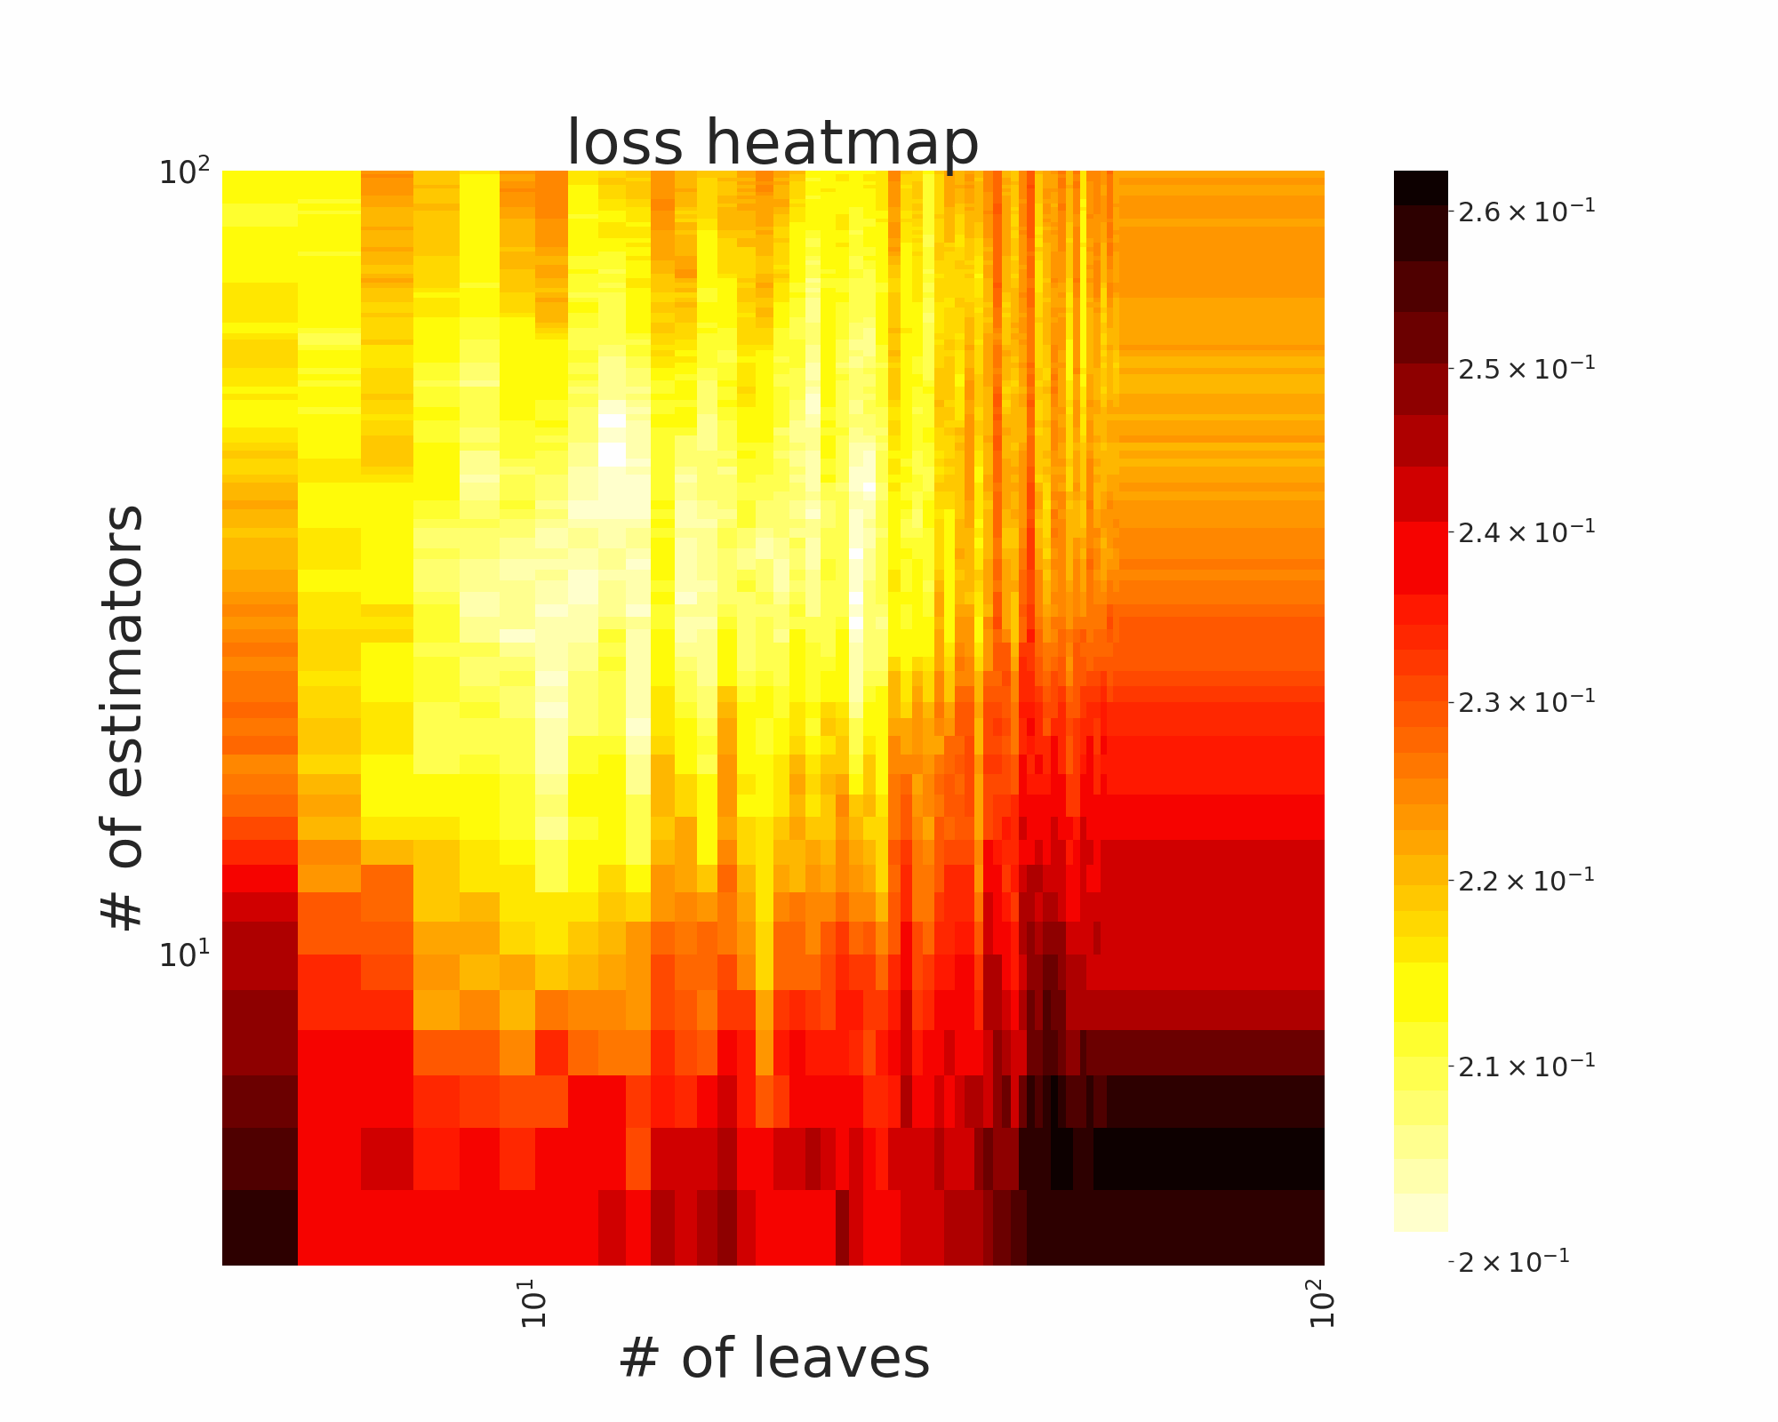
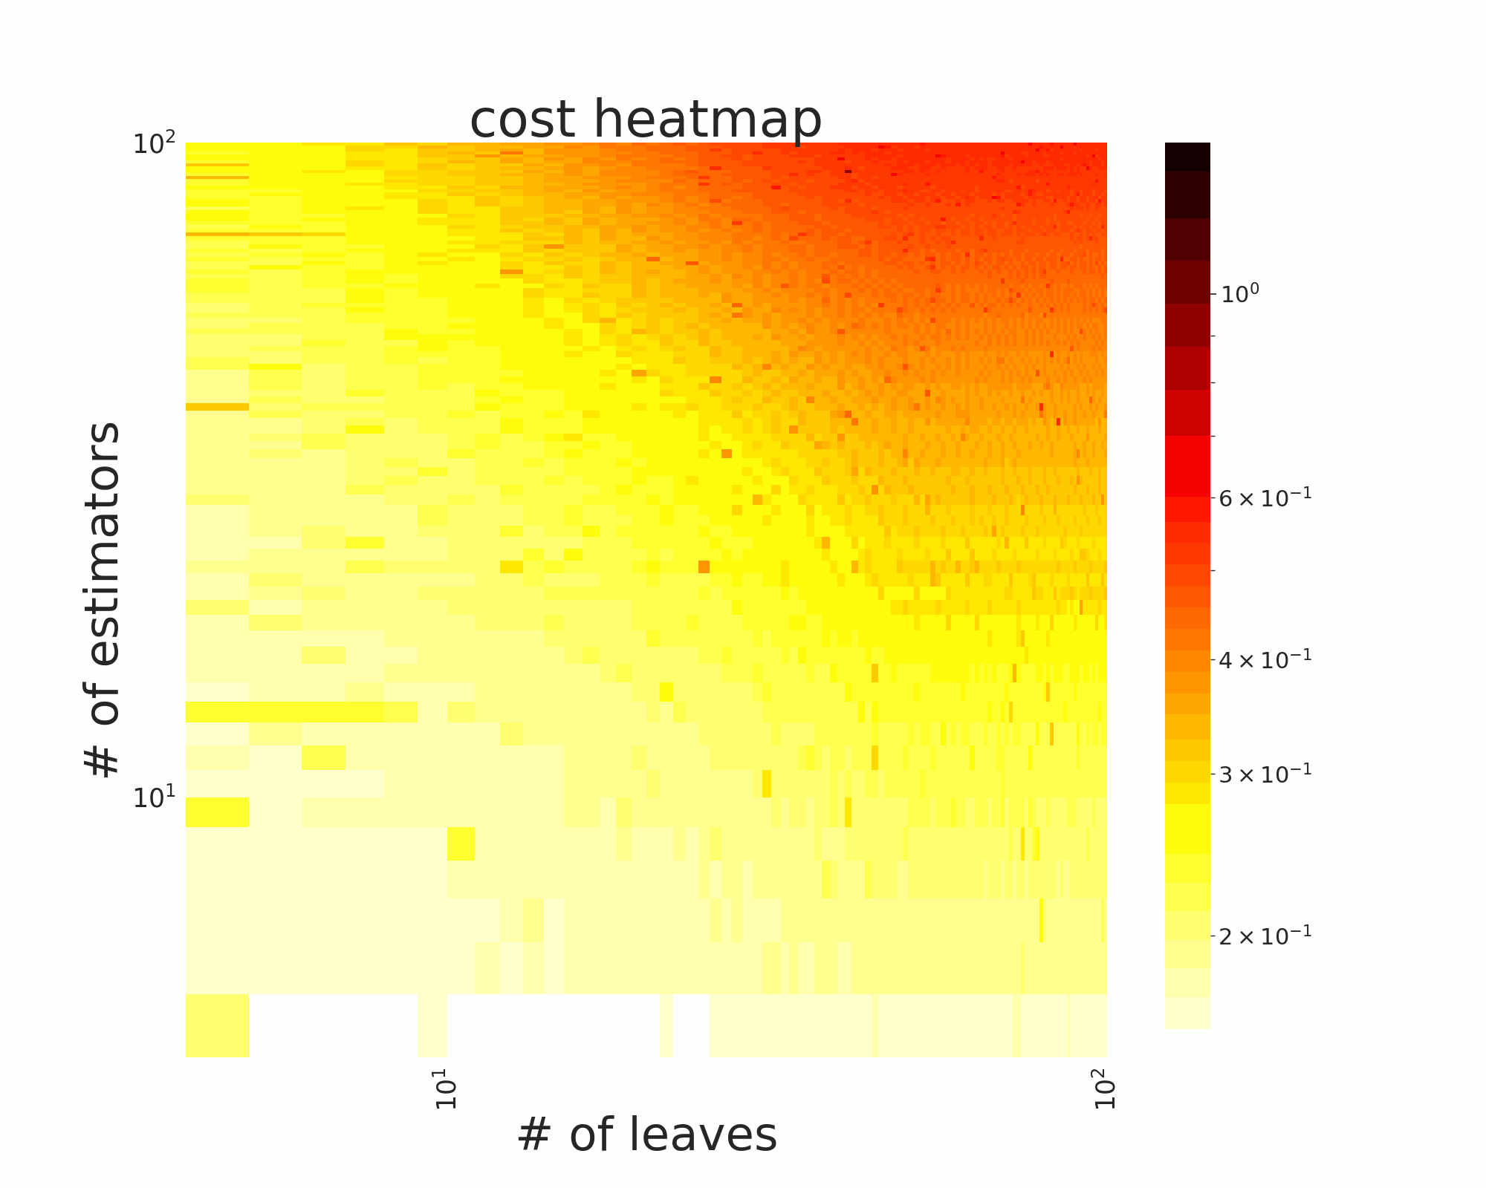
Advanced Search Algorithms
Optuna example

Slide 54
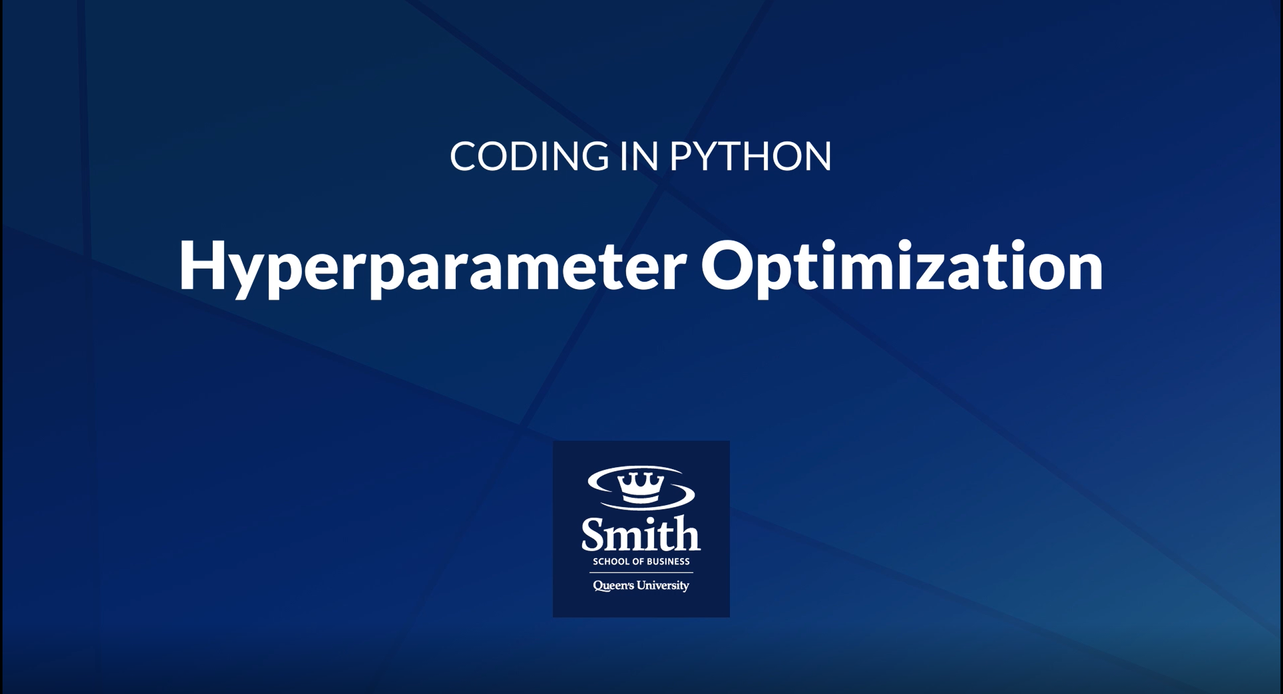
Python Tutorial
https://stream.queensu.ca/Watch/Gq8j6HKn

Slide 55
Class Imbalance

Slide 56
Imbalanced Data
Imbalanced data: data sets in which there is a disproportionate ratio of instances in one target class
 |  |  | Disease
 |  |  | No
 |  |  | No
 |  |  | No
 |  |  | No
 |  |  | Yes
 |  |  | No
 |  |  | No
 |  |  | No
 |  |  | No
 |  |  | No
In this case:
"No" = majority class (9 instances)
"Yes" = minority class (1 instances)
More common than you think! Examples:
Disease screening
Fraud detection
Customer churn
Advertising click-throughs

Slide 57
Solutions
Class weighting
Resample the data
Over sample the minority class
Generate synthetic data (SMOTE, ADYSYN)
Under sample the majority class
Packages:
Python: imbalanced-learn
R: caret

Slide 58
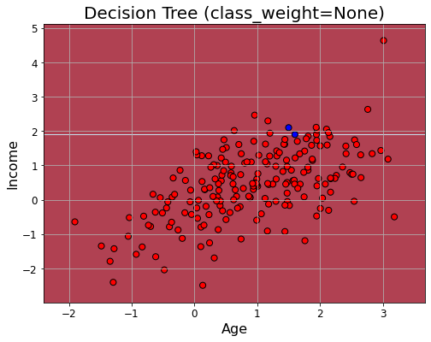
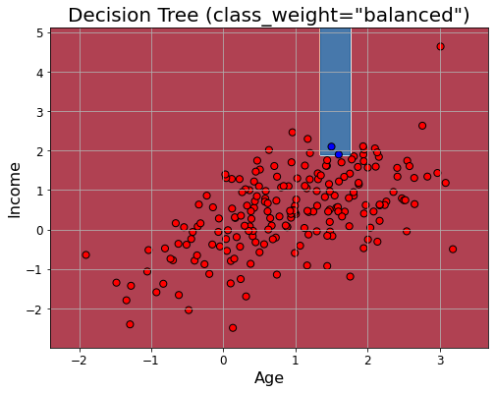
Class Weighting
Tells algorithm to increase the cost of misclassifying the minority class
clf = DecisionTreeClassifier(class_weight = "balanced")
Algorithm will adjust loss function appropriately
Simple and effective!

Slide 59
Over Sample
Randomly duplicate instances from minority class
ID |  |  | Target
1 |  |  | No
2 |  |  | No
3 |  |  | No
4 |  |  | Yes
5 |  |  | No
ID |  |  | Target
1 |  |  | No
2 |  |  | No
3 |  |  | No
4 |  |  | Yes
5 |  |  | No
4 |  |  | Yes
4 |  |  | Yes
4 |  |  | Yes
80% "No"
20% "Yes"
50% "No"
50% "Yes"

Slide 60
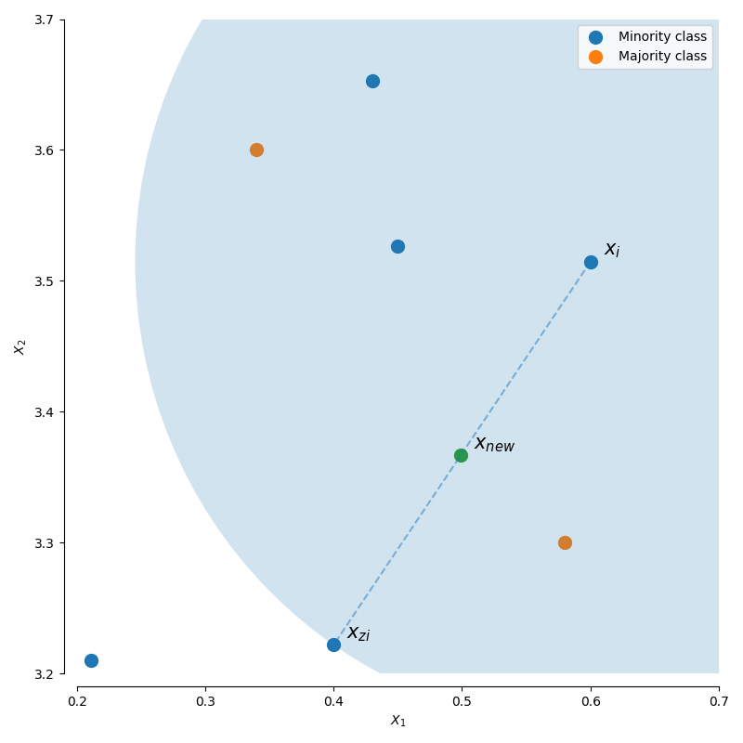
Generate Synthetic Data
Similar to over sampling, but instead generates artificial data that is “close” to an instance in the minority class
Common methods: SMOTE, ROSE, ADASYN
Continuous – interpolation
Categorical – majority level

Slide 61
Under Sample
Randomly remove instances from majority class
ID |  |  | Target
1 |  |  | No
2 |  |  | No
3 |  |  | No
4 |  |  | Yes
5 |  |  | No
6 |  |  | Yes
ID |  |  | Target
1 |  |  | No
4 |  |  | Yes
5 |  |  | No
6 |  |  | Yes
50% "No"
50% "Yes"
66% "No"
33% "Yes"

Slide 62
Exercise
Over sampling versus under sampling: when to use which?

Slide 63
Data Leakage

Slide 64
Data Leakage
When you cheat (by accident)
When training features contain information they shouldn't
Leads to "good" performance in lab, but poor performance in production
Causes you to select the wrong model
Examples:
Target leakage
Bad splitting
FE before splitting
If your results seem too good to be true, then they probably are!

Slide 65
Target Leakage
Feature determines/interacts with the target
PID | Date of Death | … | Died
1 | 10/02/2003 |  | Yes
2 | - |  | No
3 | 3/19/2019 |  | Yes
4 | - |  | No
5 | 03/03/2013 |  | Yes
6 | - |  | No
7 | - |  | No
8 | - |  | No
9 | 01/02/1987 |  | Yes
10 | - |  | No
PID | Monthly Salary | … | Yearly Salary
1 | $4,000 |  | $48,000
2 | … |  | …
3
4
5
6
7
8
9
10

Slide 66
Bad Splitting
Splitting non-i.i.d. randomly
E.g., time-correlated data
Feb 5, 2022
Jan 2, 2022
Jan 8, 2022
Jan 1, 2022
Feb 18, 2022
Jan 15, 2022
Jan 4, 2022
Jan 1, 2022
Jan 3, 2022
Feb 5, 2022
Jan 8, 2022
Jan 15, 2022
Jan 4, 2022
Jan 15, 2022
Jan 1, 2022
Jan 1, 2022
Jan 2, 2022
Jan 3, 2022
Jan 4, 2022
Jan 4, 2022
Jan 8, 2022
Jan 1, 2022
Jan 1, 2022
Jan 2, 2022
Jan 3, 2022
Jan 4, 2022
Jan 4, 2022
Jan 8, 2022
Jan 15, 2022
Jan 15, 2022
Feb 5, 2022
Feb 18, 2022
Jan 1, 2022
Jan 1, 2022
Jan 2, 2022
Jan 3, 2022
Training
Training
Training
Jan 4, 2022
Jan 4, 2022
Jan 8, 2022
Jan 15, 2022
Jan 15, 2022
Feb 5, 2022
Feb 18, 2022
Jan 15, 2022
Training
Jan 15, 2022
Jan 3, 2022
Jan 1, 2022
Jan 2, 2022
Jan 4, 2022
Jan 1, 2022
Jan 15, 2022
Jan 4, 2022
Feb 18, 2022
Jan 2, 2022
Jan 15, 2022
Jan 15, 2022
Feb 5, 2022
Feb 18, 2022
Jan 15, 2022
All data
Testing
Testing
Testing
Testing
Regular K-fold splits
Time Series splits
BAD
All test instances shoud occur after all train instances
GOOD

Slide 67

Bad Splitting
The right way to think about time-data:

Slide 68
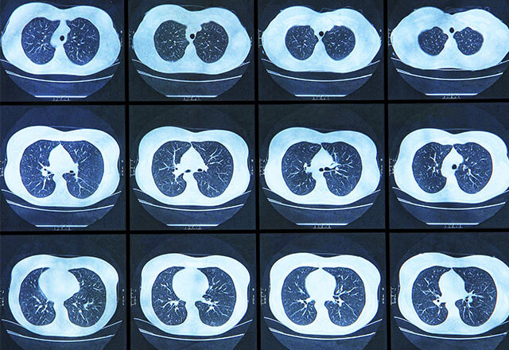
Bad Splitting
E.g., group-correlated data
Image ID | Patient ID | Image | Cancer?
1 | 1 | -1.511 | Yes
2 | 1 | 0.251 | Yes
3 | 2 | -1.169 | No
4 | 2 | 0.962 | No
5 | 3 | -0.147 | No
6 | 4 | 1.395 | Yes
All instances for a given patient should be in the same split

Slide 69
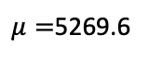
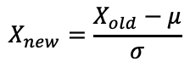
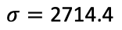
FE Before Splitting
Training data is influenced by testing data
PID | Salary_Std
1 | -1.511
2 | 0.251
3 | -1.169
4 | 0.962
5 | -0.147
6 | 1.395
7 | -0.897
8 | 0.618
9 | -0.814
10 | -0.013
11 | 0.584
12 | -1.111
13 | 0.993
14 | 0.772
15 | -1.202
PID | Salary
1 | 1169.0
2 | 5951.0
3 | 2096.0
4 | 7882.0
5 | 4870.0
6 | 9055.0
7 | 2835.0
8 | 6948.0
9 | 3059.0
10 | 5234.0
11 | 6854.0
12 | 2255.0
13 | 7965.0
14 | 7365.0
15 | 2006.0
16 | 10365.0
17 | 1006.0
18 | 4532.0
19 | 6395.0
20 | 7551.0
PID | Salary_Std
1 | -1.511
2 | 0.251
3 | -1.169
4 | 0.962
5 | -0.147
6 | 1.395
7 | -0.897
8 | 0.618
9 | -0.814
10 | -0.013
11 | 0.584
12 | -1.111
13 | 0.993
14 | 0.772
15 | -1.202
16 | 1.877
17 | -1.571
18 | -0.272
19 | 0.415
20 | 0.840
$$X_{new}=\frac{X_{old}−μ}{σ}$$
Training
$μ=$5269.6
$$σ=\text{2714.4}$$
PID | Salary_Std
16 | 1.877
17 | -1.571
18 | -0.272
19 | 0.415
20 | 0.840
Testing

Slide 70
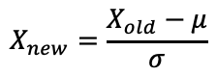
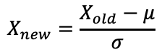
The Proper Way
PID | Salary_Std
1 | 1169.0
2 | 5951.0
3 | 2096.0
4 | 7882.0
5 | 4870.0
6 | 9055.0
7 | 2835.0
8 | 6948.0
9 | 3059.0
10 | 5234.0
11 | 6854.0
12 | 2255.0
13 | 7965.0
14 | 7365.0
15 | 2006.0
PID | Salary_Std
1 | -1.534
2 | 0.363
3 | -1.166
4 | 1.128
5 | -0.066
6 | 1.594
7 | -0.873
8 | 0.758
9 | -0.784
10 | 0.078
11 | 0.721
12 | -1.103
13 | 1.161
14 | 0.923
15 | -1.202
PID | Salary
1 | 1169.0
2 | 5951.0
3 | 2096.0
4 | 7882.0
5 | 4870.0
6 | 9055.0
7 | 2835.0
8 | 6948.0
9 | 3059.0
10 | 5234.0
11 | 6854.0
12 | 2255.0
13 | 7965.0
14 | 7365.0
15 | 2006.0
16 | 10365.0
17 | 1006.0
18 | 4532.0
19 | 6395.0
20 | 7551.0
$$X_{new}=\frac{X_{old}−μ}{σ}$$
Training
Training
PID | Salary_Std
16 | 10365.0
17 | 1006.0
18 | 4532.0
19 | 6395.0
20 | 7551.0
PID | Salary_Std
16 | 2.113
17 | -1.598
18 | -0.200
19 | 0.539
20 | 0.997
$$X_{new}=\frac{X_{old}−μ}{σ}$$
Testing
Testing

Slide 71
Comparison
FE before split
Proper
PID | Salary_Std
1 | -1.511
2 | 0.251
3 | -1.169
4 | 0.962
5 | -0.147
6 | 1.395
7 | -0.897
8 | 0.618
9 | -0.814
10 | -0.013
11 | 0.584
12 | -1.111
13 | 0.993
14 | 0.772
15 | -1.202
PID | Salary_Std
1 | -1.534
2 | 0.363
3 | -1.166
4 | 1.128
5 | -0.066
6 | 1.594
7 | -0.873
8 | 0.758
9 | -0.784
10 | 0.078
11 | 0.721
12 | -1.103
13 | 1.161
14 | 0.923
15 | -1.202
Training
Training
PID | Salary_Std
16 | 1.877
17 | -1.571
18 | -0.272
19 | 0.415
20 | 0.840
PID | Salary_Std
16 | 2.113
17 | -1.598
18 | -0.200
19 | 0.539
20 | 0.997
Testing
Testing

Slide 72
Another Example: Upsampling before Splitting
BAD! Why?
…
U.S.
Training
All data
Upsampled
data
Testing

Slide 73
Avoiding and Detecting Leakage
Train/fit feature transformations on the training ONLY
Not on validation/test
Check feature importance
Do top features make sense?
Understand the meaning of every feature
For every feature, ask: "Will I have this feature at prediction time? What values can it have?"
Source: Target Leakage in ML, Yuriy Guts, 2018

Slide 74
Exercise: Which leads to which?
Benefits
ML Task
Prevent data leakage
Feature engineering
Feature selection
Hyperparameter tuning
Fixing class imbalance
Using pipelines
Cross validation
Stop model overfitting
Stop model underfitting
Faster training time
Increase model performance
Easier to prep testing/future data
Easier coding
Obtain accurate estimate of model performance

Slide 75
Summary
Feature engineering: creating newer, more awesome features
Transformations: scaling, encoding, …
If you don't do it: your model won't have the best information, and it won't achieve as good performance
Feature selection: selecting only the best features
Filter, wrapper
If you don't do it: extra features may hurt performance
Hyperparameter tuning: finding the best values for hyperparameters
Grid search, random search
If you don't do it: Probably leaving a lot of performance on the table
Class imbalance: when one target class is dominant
Class weights or resampling
If you don't do it: model will over-predict majority class, hurting performance
Data leakage: when training data has info it shouldn't
Target leakage, train-test contamination
If you don't control it: your model will likely overfit, and you will think your model is better than it really is

Slide 76
Appendix: pipelines

Slide 77
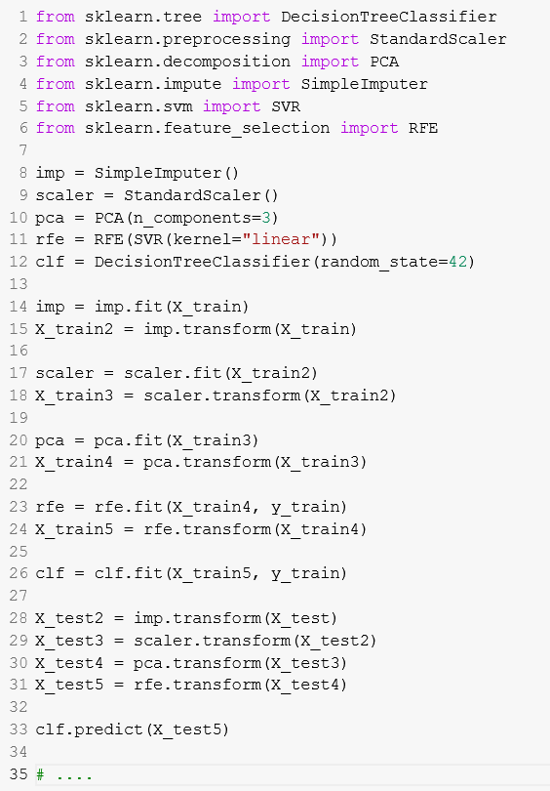
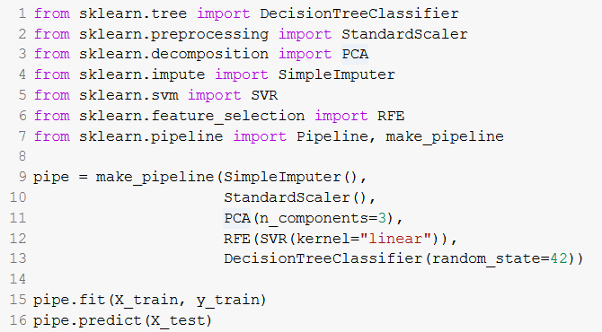
Motivation
Must manually chain together transformations
fit() calls all Transformers and Estimators properly
Must do all the same transforms to test data
predict() calls all Transformers and Estimators properly
This doesn't even do cross validation; would have to put this al in a loop

Slide 78
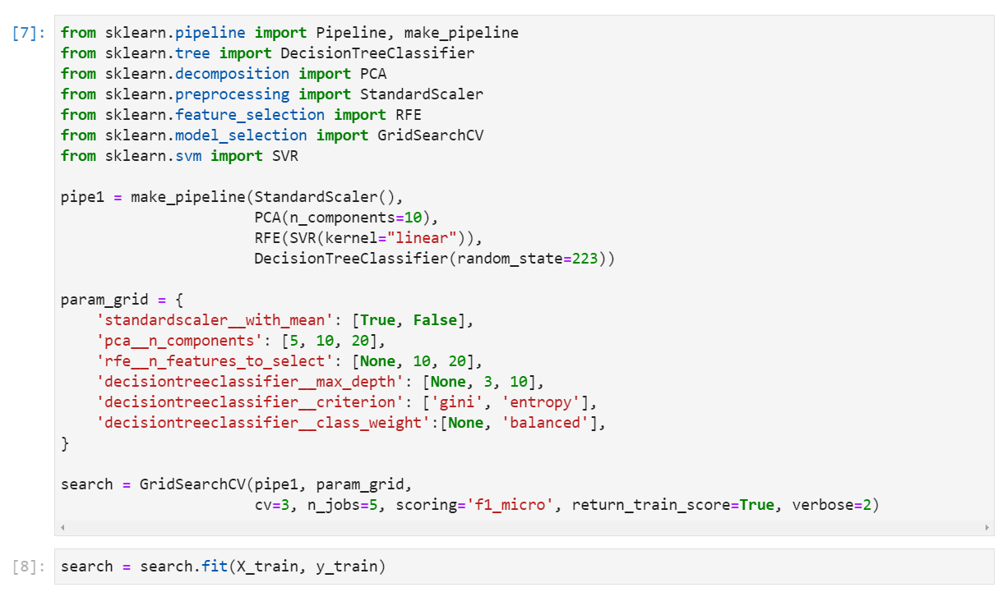
Pipelines: The Easier Way
Way to put all FE, FS, etc. steps together in one object
Can easily fit/train transformers on just training data
Can re-use pipeline easily on new test data; all steps will be applied
Feature Engineering
Feature Selection
Hyper Parameter Tuning
Cross Validation

Slide 79

Pipelines

Slide 80
Pipelines Do It all Under the Hood!
Repeat K times
Impute
max_depth=4, …
Scale
Sample
DT
Model
F1 = 79%
Select
train
transformed
train
…
raw
test
transformed
test

Slide 81

Quick Tutorial by Data School
Use Pipeline to chain together multiple steps (3:11)

